Slide 1
Measurement of Carbon Dioxide Levels Above Chuska Mountain As Measured By High Altitude Balloon
Presentation by LeTanya Thinn, Urian Yazzie, Tyler Begay, and William Connell

Slide 2
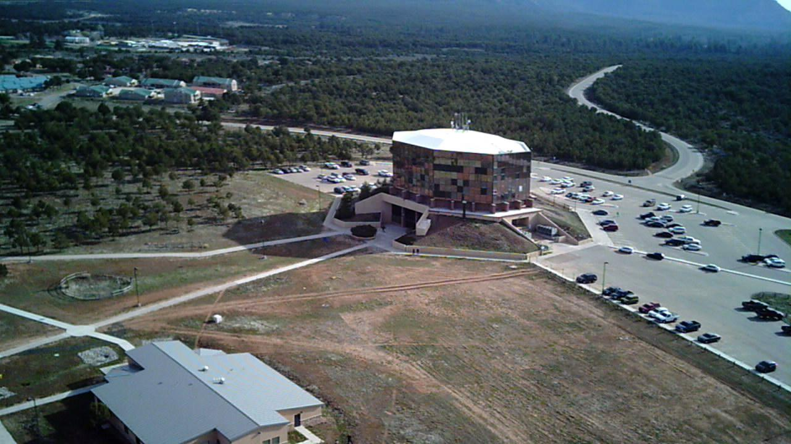
Contents
Background (LeTanya Thinn)
Diné Philosophy
Experimental Procedure (Tyler Begay)
Results
Analysis
Improvements (William Connell)
Long Term Goals
Acknowledgements

Slide 3
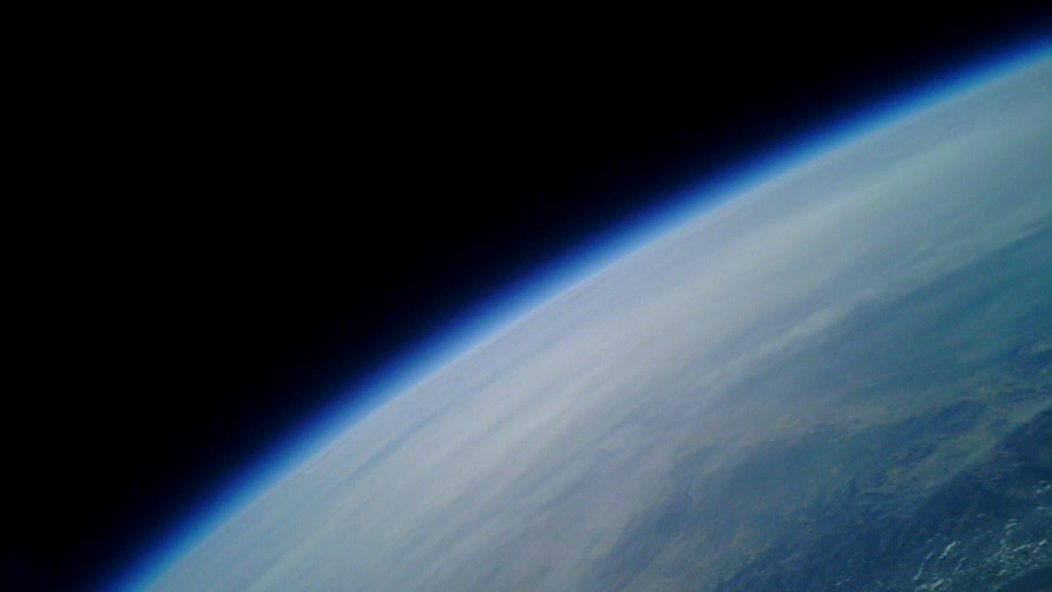
Background
Atmospheric carbon dioxide at an all time high and a source of greenhouse effect.
With global temperatures rising, importance of measuring carbon dioxide essential.
Goal: obtain knowledge of gas measuring techniques and proficiency in execution of procedures to obtain valuable data of carbon dioxide in atmosphere of Navajo Nation.

Slide 4
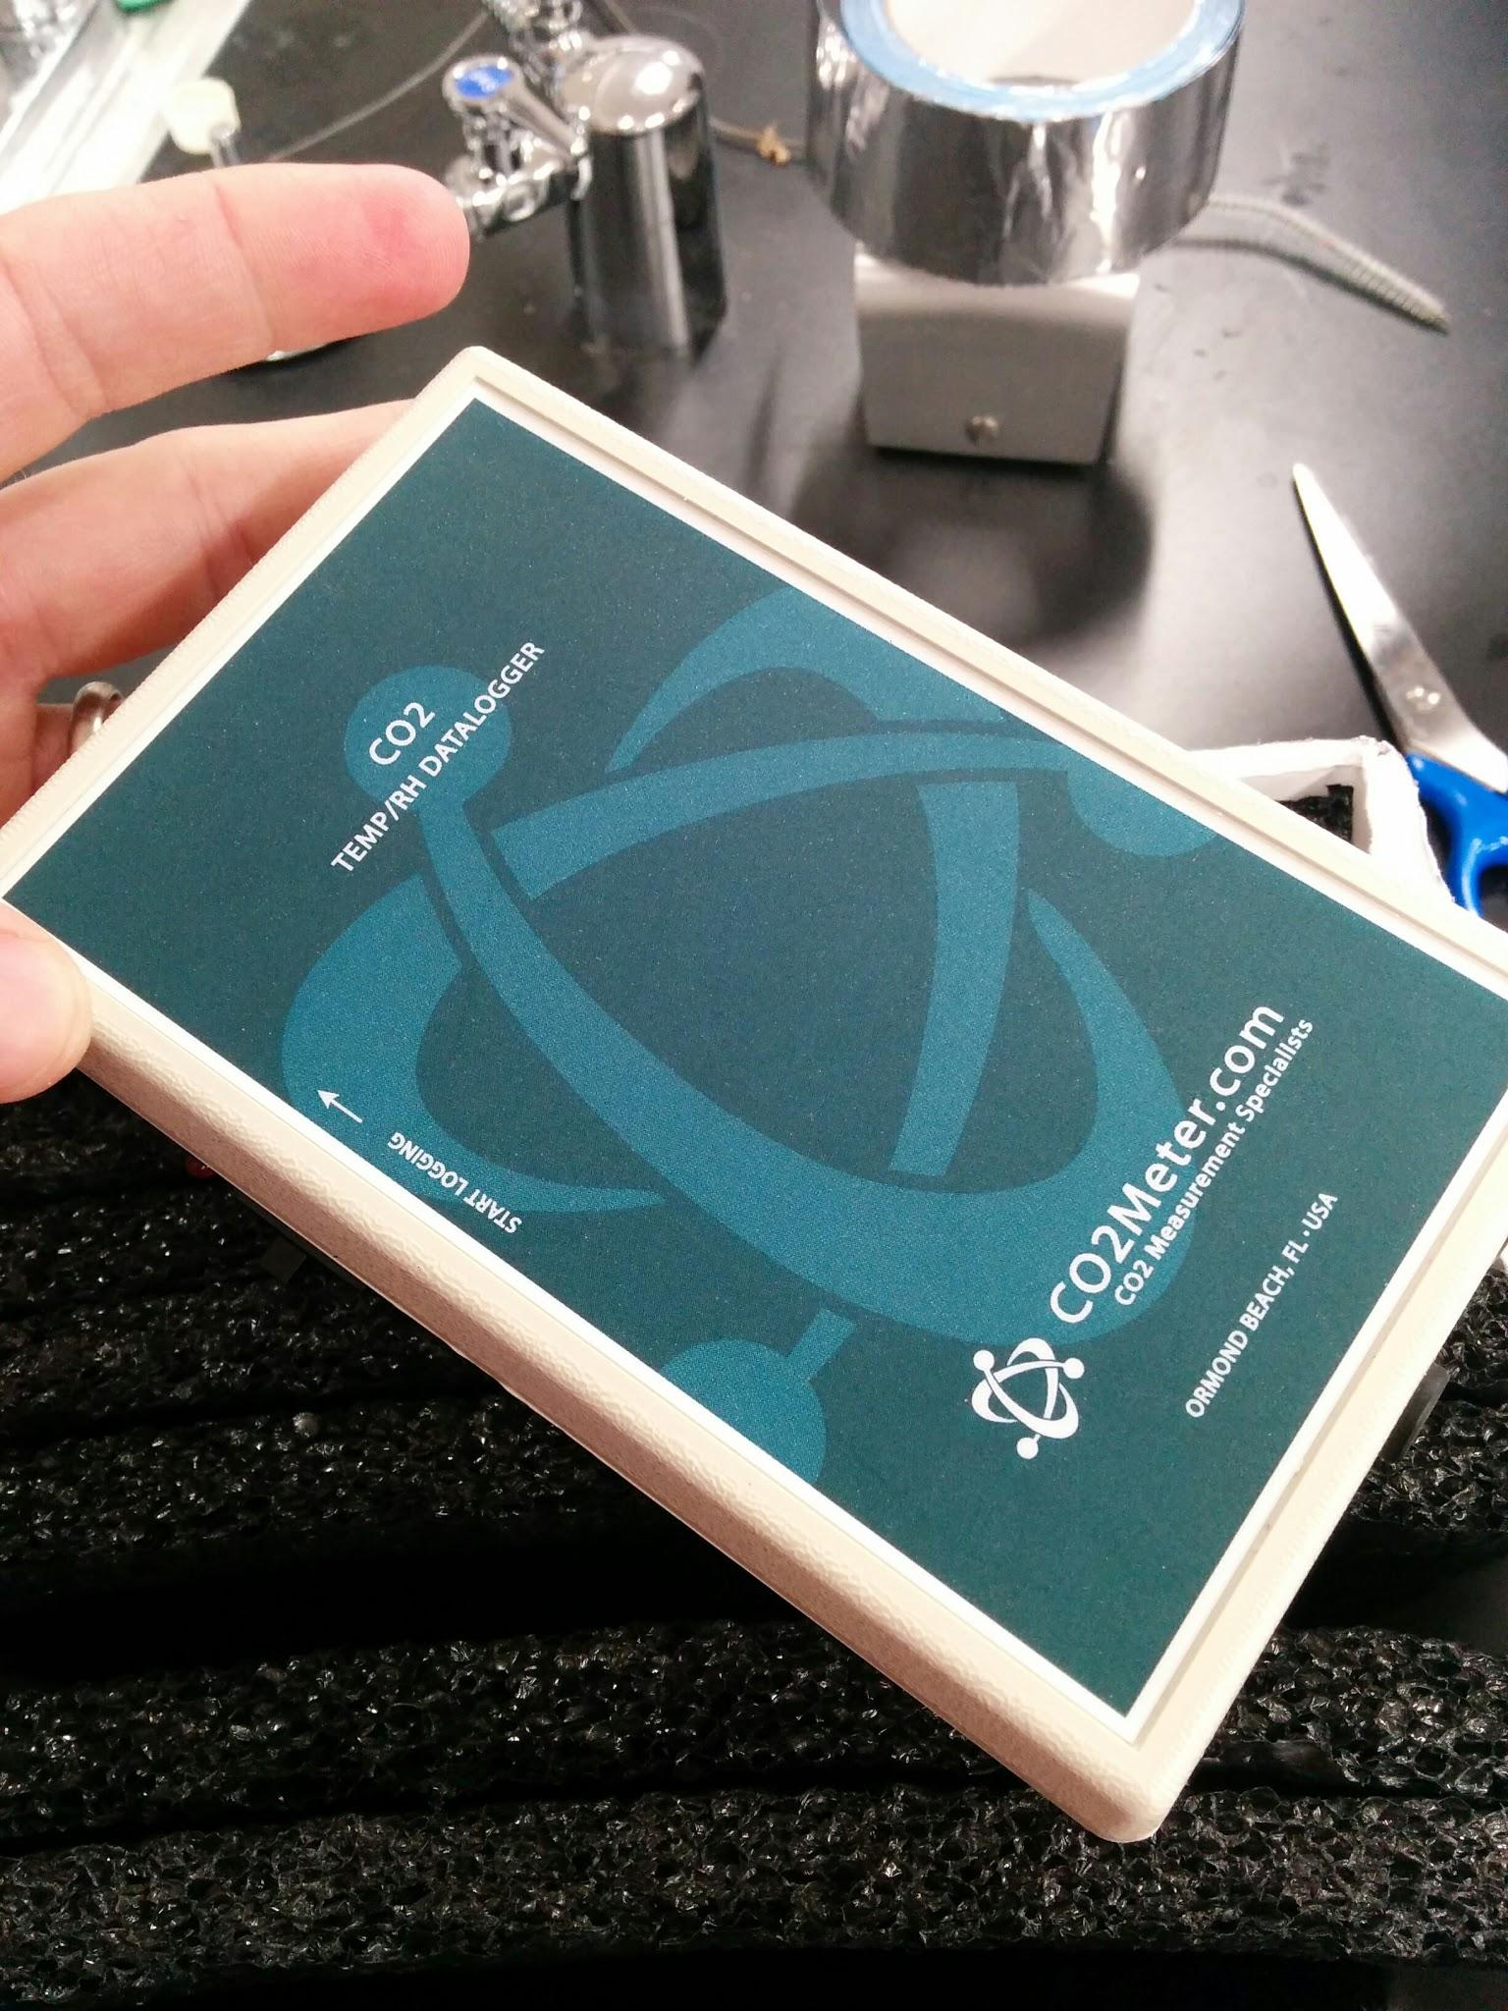
Experimental Procedure
Sensor Research
Gas
Function Type
Payload Assembly
Box walls
Insulation cut-out
Launch and Recovery
Data Recovery
Sensor Testing
O2/N2
N2/10%CO2

Slide 5
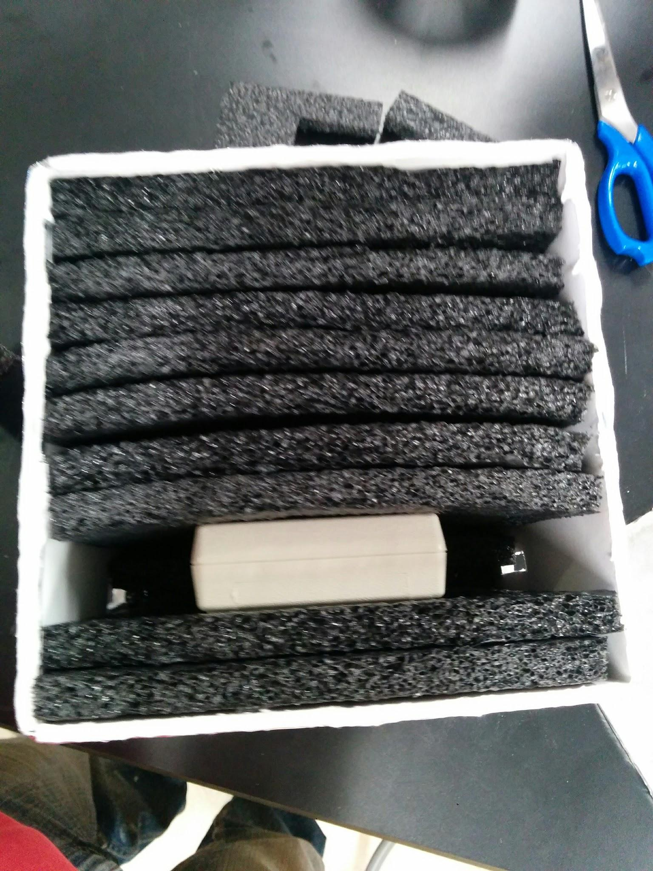
CO2 Sensor: CM-0018 - CO2, Temperature, Humidity
0-10,000 ppm
Internal memory
30s logging interval
AA powered
GasLab interface
3 air intakes

Slide 6
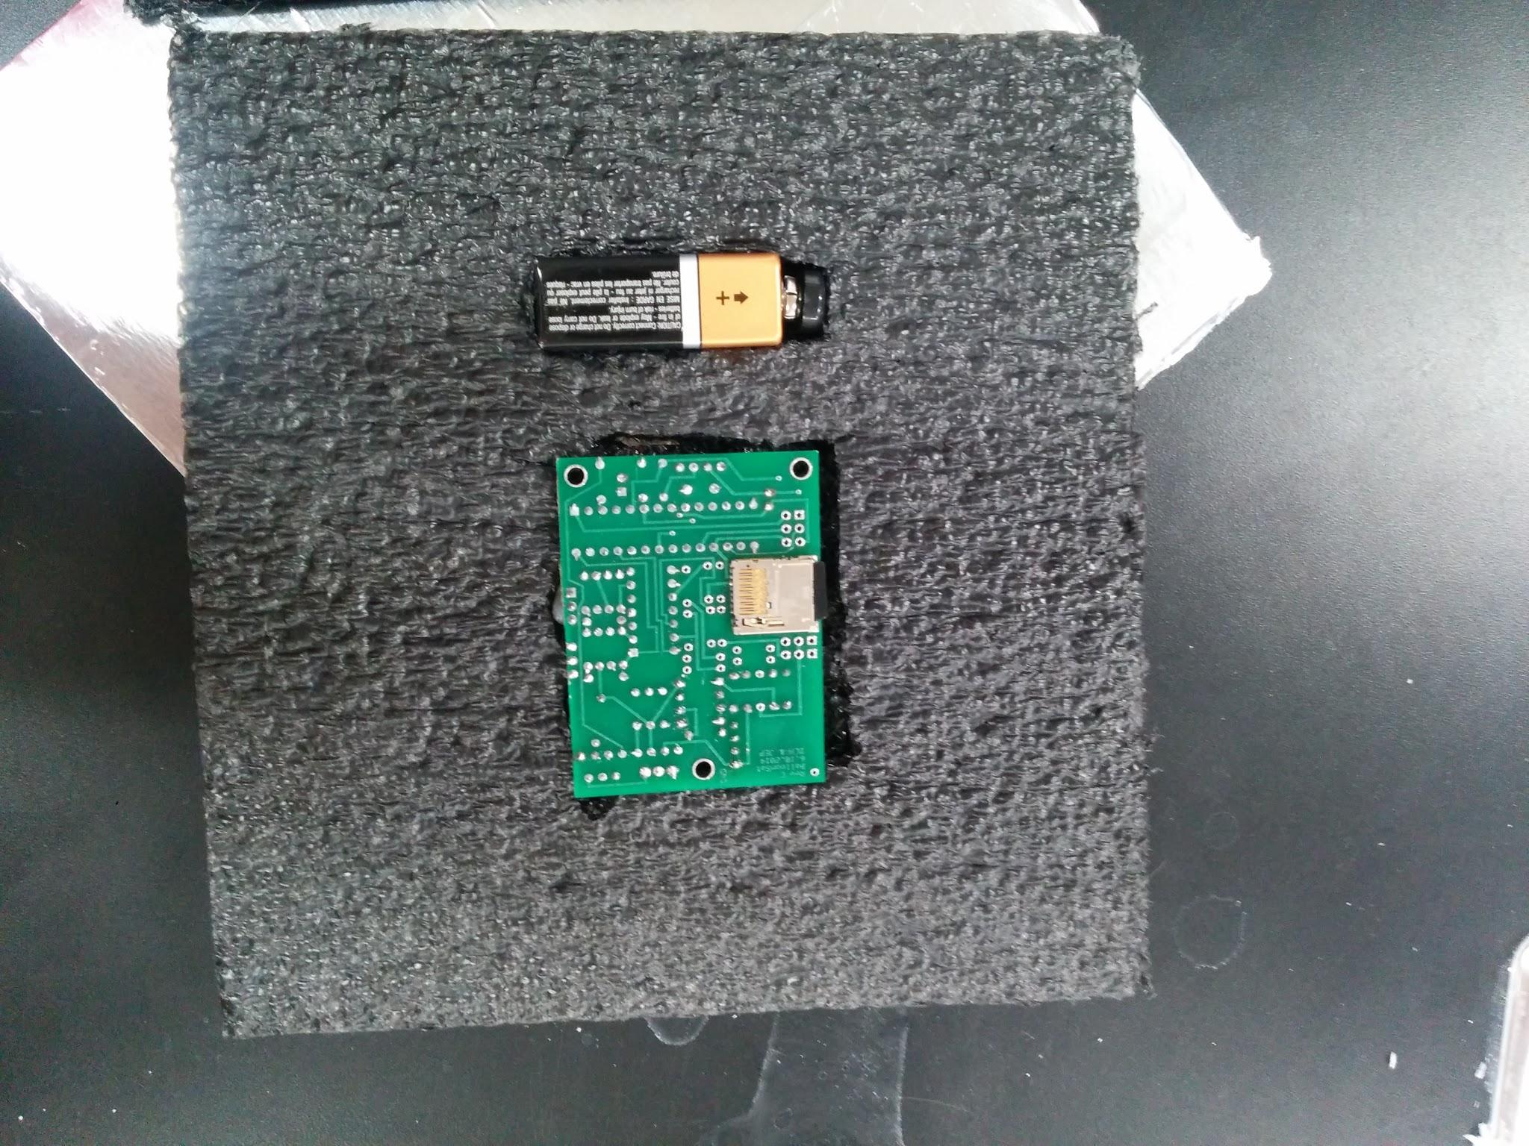
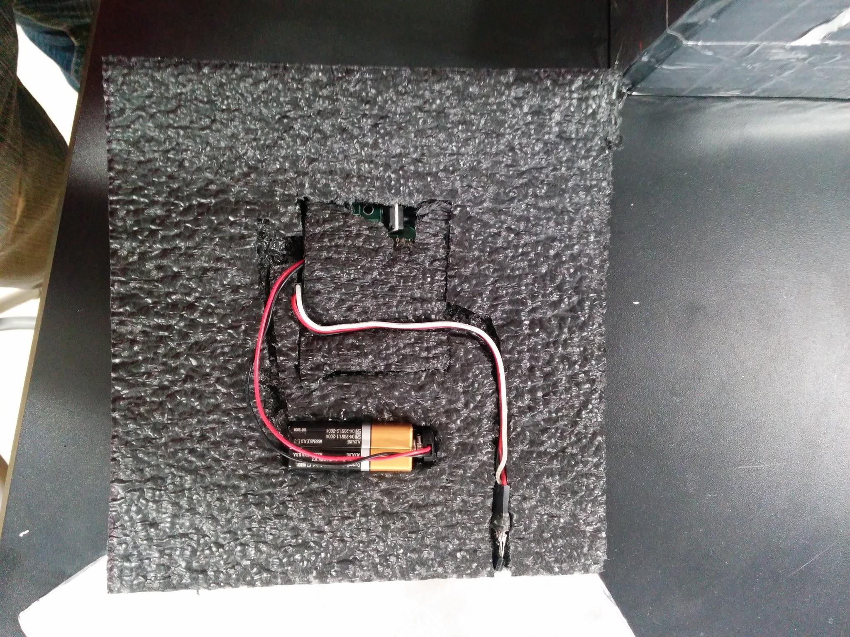

Slide 7
Results

Slide 8
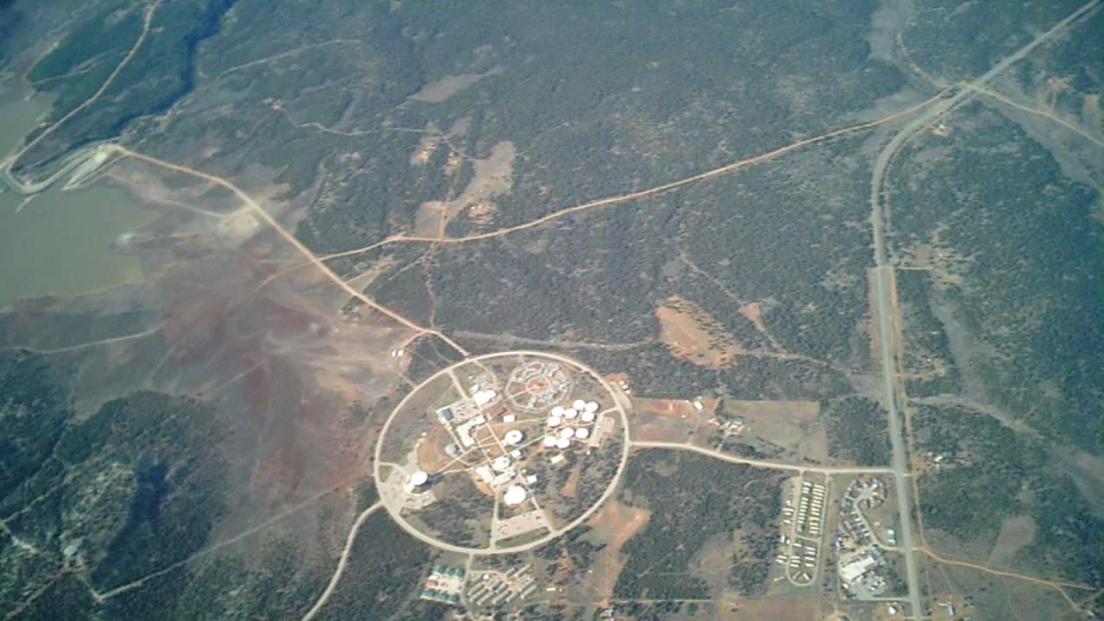
Analysis
Erratic gas, temperature, humidity sensor data
Sensor testing suggests proper functioning of all measurables
Data appears to be affected by changes in pressure and temperature
Durations of data measure indicate shutoff

Slide 9
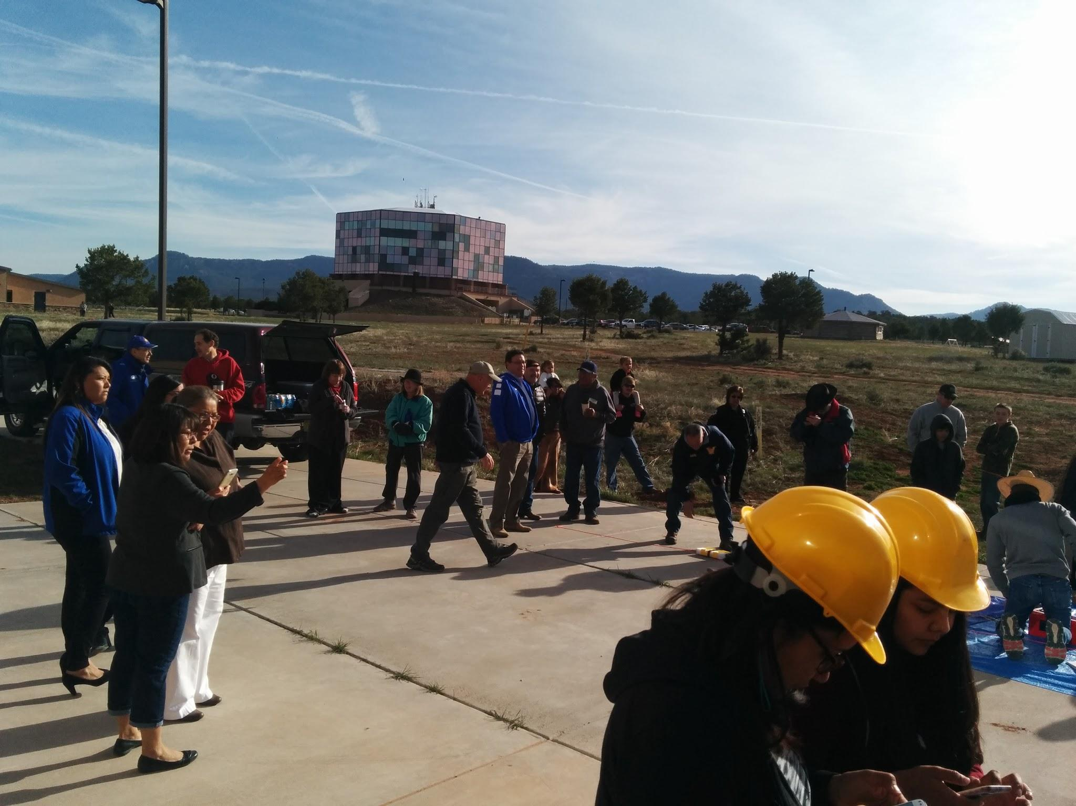
Improvements
Calibration
Ground Level
Vacuum
Low Temperature
Control Environments
Sensor Preparation
Internal Time
GasLab Software Documentation
Correcting for Conditions at Altitude
Pressure
Temperature

Slide 10
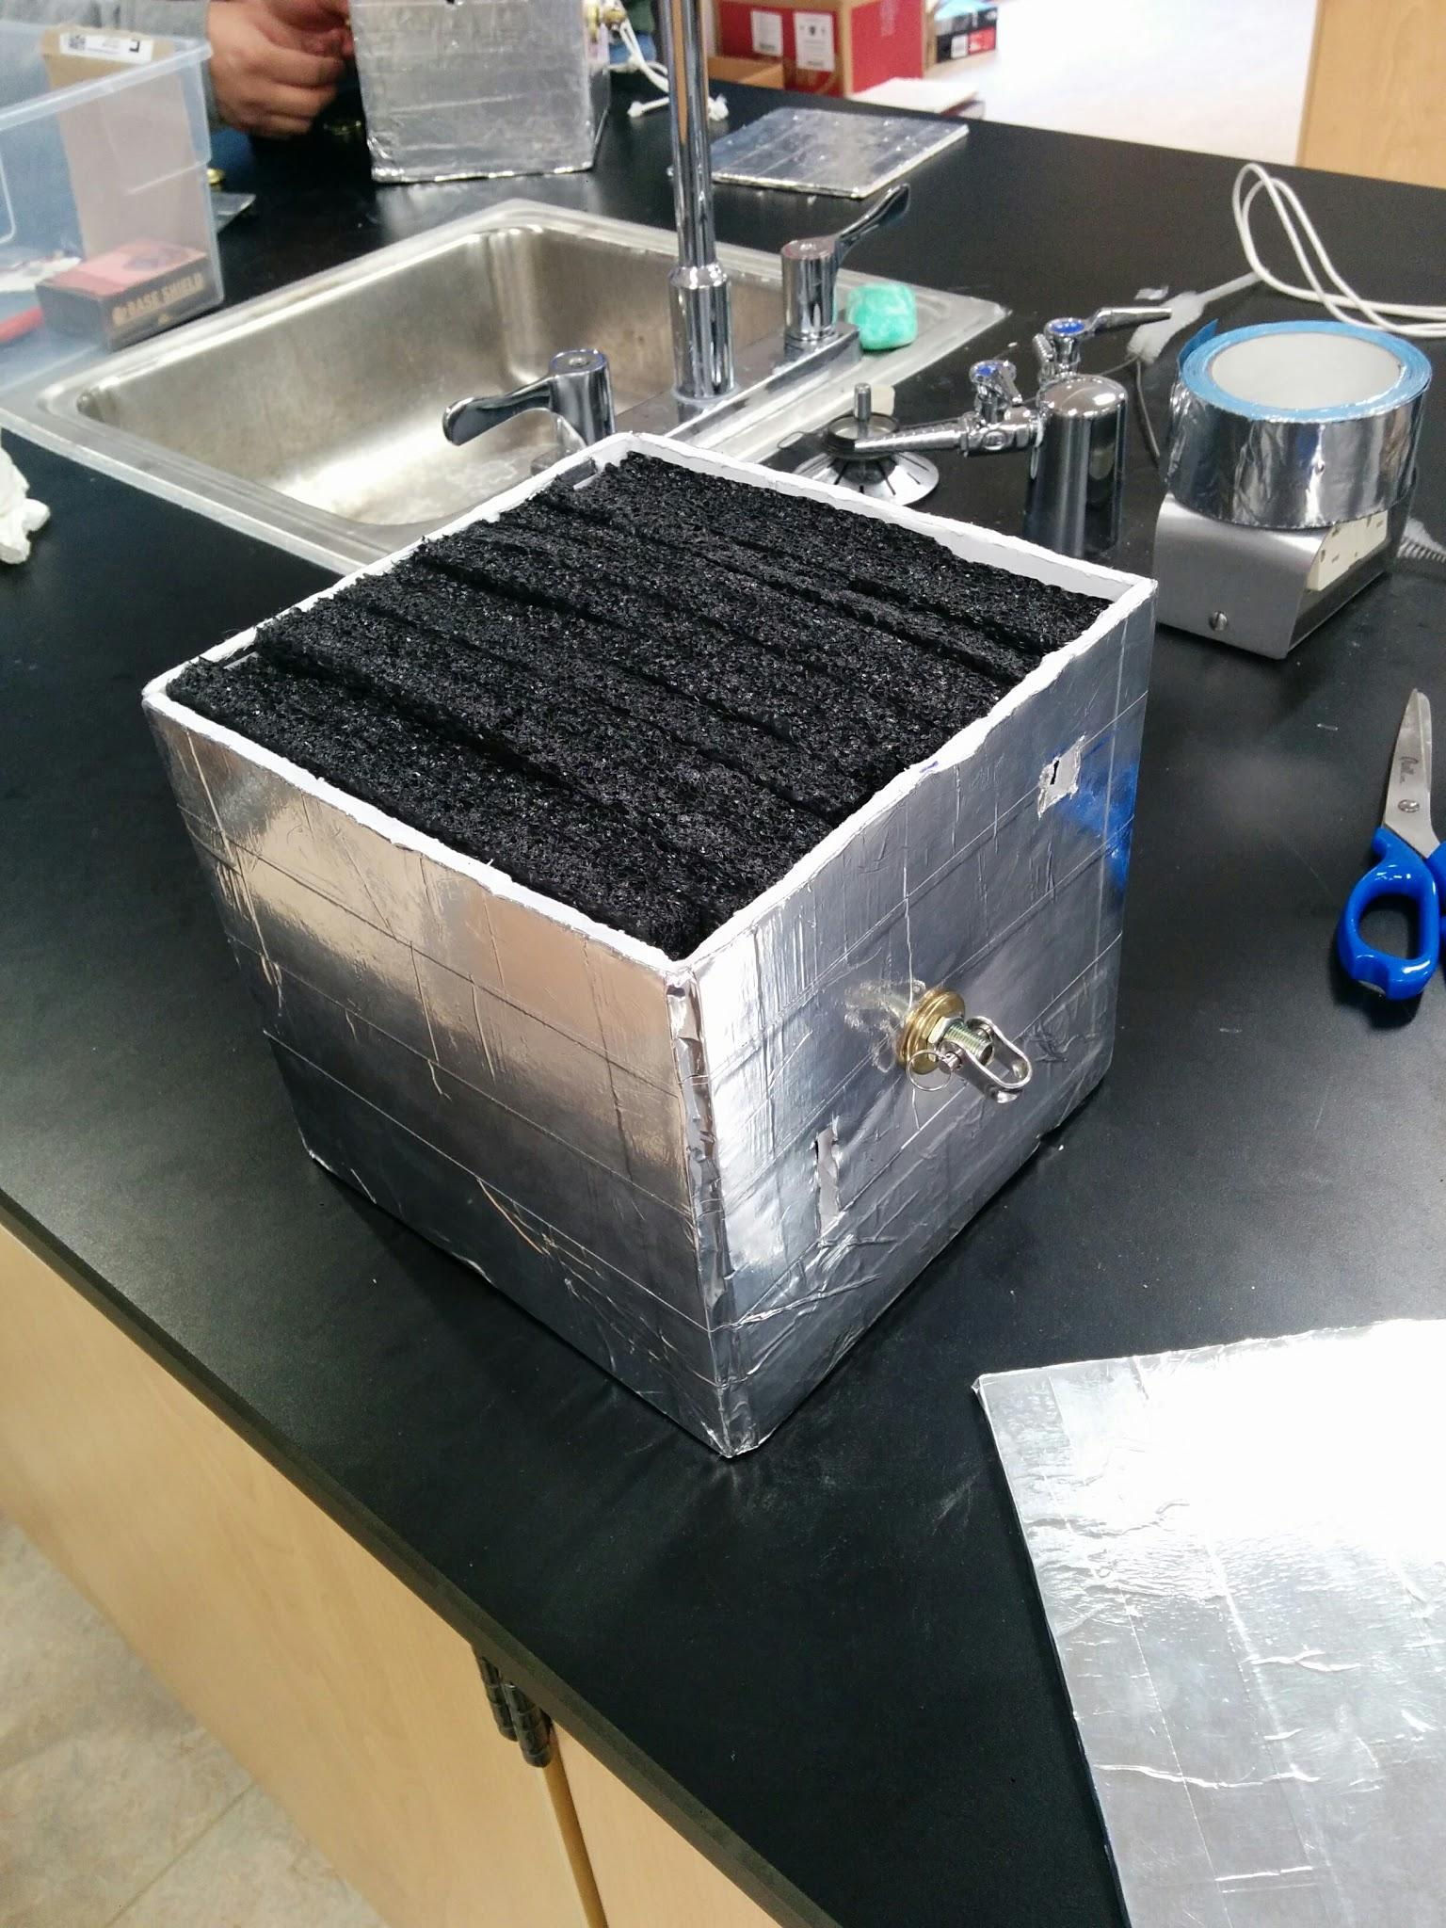
Long Term Goals
Improve Data Collection
Consistent accuracy
Observe Trends
Yearly measurements
Develop Familiarity With Techniques
Proficiency with instrumentation/collection
Monitor Navajo Nation
Provide Meaningful Data
Applicable to Community Health

Slide 11
Acknowledgements
Susan Brew, Arizona Space Grant Consortium, Jack Crabtree, Francis Burns, Juanita Francis, NASA and More.

